Slide 1
Udyog Saarthi App
CSE7101- Capstone Project
Final-Review
Batch Number:ISE-13
Under the Supervision of:
Ms .Smitha S P
Assistant Professor
School of Computer Science and Engineering
Presidency University
Roll Number | Student Name
20221ISE0088 | Pruthvi BS
20221ISE0117 | Ganavi HR
20221ISE0135 | Chandrakala KT
Name of the Program: Btech Information science and engineering
Name of the HoD: Dr.Zafar Ali Khan N
Name of the Program Project Coordinator: Ms. Suma NG
Name of the School Project Coordinators: Dr. Sampath A K , Dr. Geetha A

Slide 2
Problem Statement Number: PSCS_39
Organization: Ministry of Social Justice & Empowerment.
Category :Software
Problem Description:
Persons with Disabilities (PwDs), especially under categories D & E (Intellectual Disability, Autism Spectrum Disorder, Multiple Disabilities, Mental Illness, Specific Learning Disabilities), face challenges in accessing job notifications, awareness of 4% job reservation, and coaching opportunities. Lack of curated, accessible content and low literacy among parents further limits their employability, leading to unemployment for nearly 64% of PwDs in India.

Slide 3
Problem Statement:
Despite progress in accessibility and skill development, 64% of Persons with Disabilities (PwDs) in India remain unemployed. Particularly those under D & E categories (Intellectual Disability, Autism, Multiple Disabilities, Mental Illness, Specific Learning Disabilities) struggle due to lack of awareness, inaccessible job notifications, and low parental literacy.
This leads to missed opportunities under the 4% reservation, preventing PwDs from securing dignified jobs and limiting their inclusion in society. There is a strong need for a centralized, accessible platform that bridges the gap between job opportunities, coaching support, and awareness.

Slide 4
Objective:
Build an accessible Progressive Web App (PWA) for PwDs.
Provide job notifications, application tracking, and training resources.
Allow admins to post/remove jobs with feedback reasons.
Enable PwDs to register, log in, and apply easily.
Contribute to inclusion and employability under the RPwD Act, 2016.

Slide 5
Literature Review :
Existing portals (like Naukri, Employment News) lack accessibility.
No disability-specific filters or assistive features.
PwDs and parents often unaware of training opportunities.
Udyog Saarthi fills this gap with an inclusive PWA approach.

Slide 6
Proposed System:
Web-based system accessible from any device.
Modules:
User Module: Registration, Login, Apply Jobs
Admin Module: Post Jobs, View/Remove Applications
Job Module: Display jobs, Filter by disability
Utility Module: Navigation, Logout, Notifications
Data Storage: Browser localStorage
Technologies: HTML, CSS, JavaScript, PWA Manifest

Slide 7
Algorithm:
Example: User Registration
Input: Name, Email, Password, Disability
Check if email exists in localStorage
If not → Save user → redirect to Login
Else → Alert: “Already Registered”
Example: Job Posting (Admin)
Input Job Title, Description, Disability
Save job in “jobs” array in localStorage
Display on user homepage

Slide 8
Flowchart and Implementation:
Admin → Post Job → Job Module → Apply Job → User Applications → Admin Feedback
Implementation:
Frontend: HTML, CSS, JavaScript
Storage: localStorage
Features:
  Registration & Login
  Job posting & removal with feedback
  My Applications & Removed Applications view
  PWA installable on mobile devices
Accessibility: Responsive design, large fonts, simple navigation

Slide 9
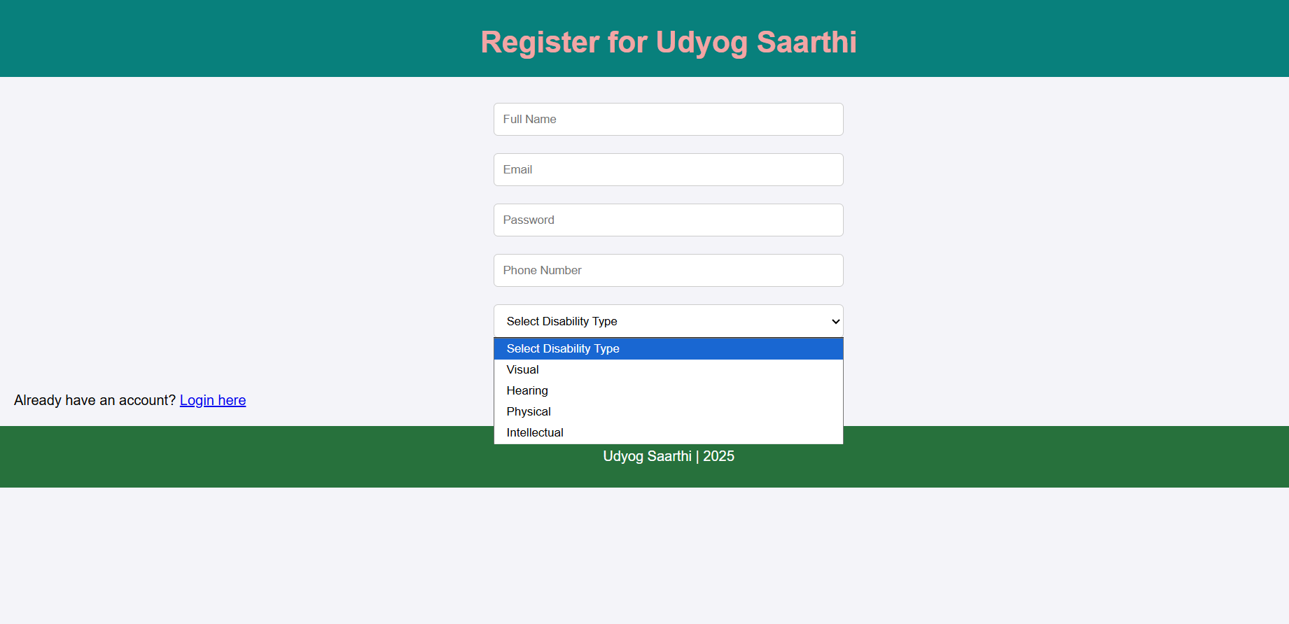
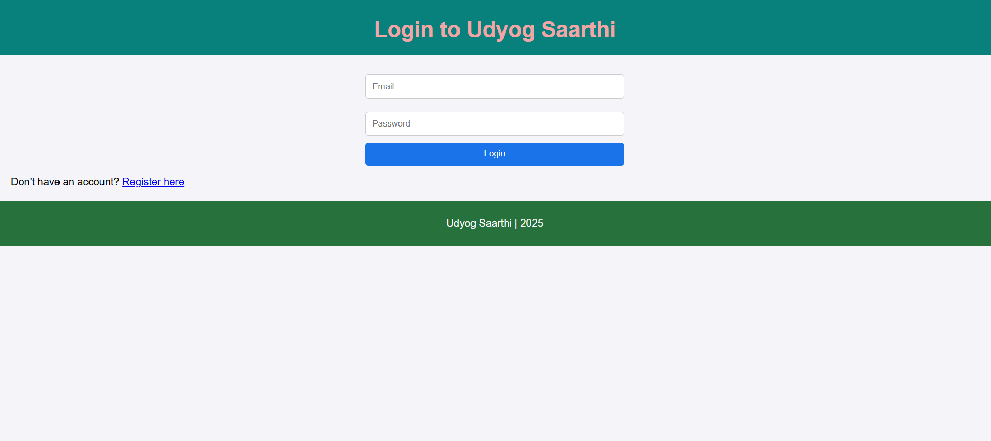
Output Screenshots:
User Registration Page:
Login Page:

Slide 10
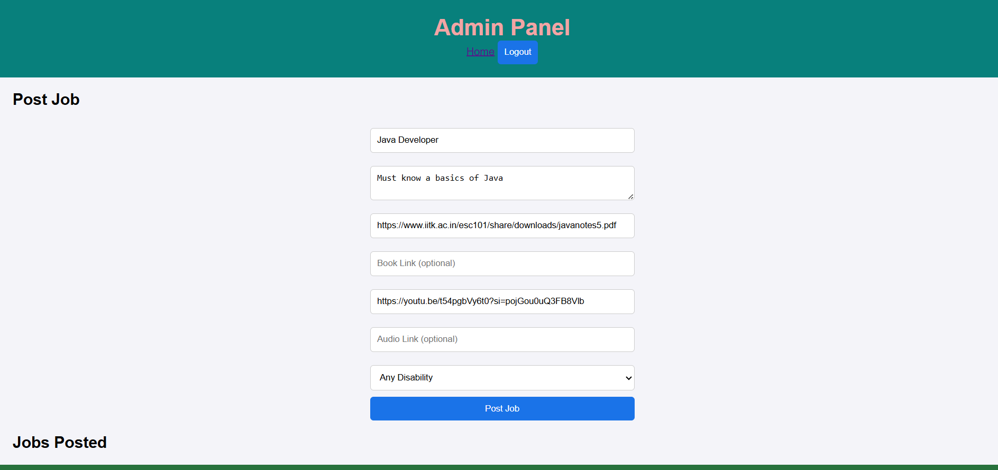
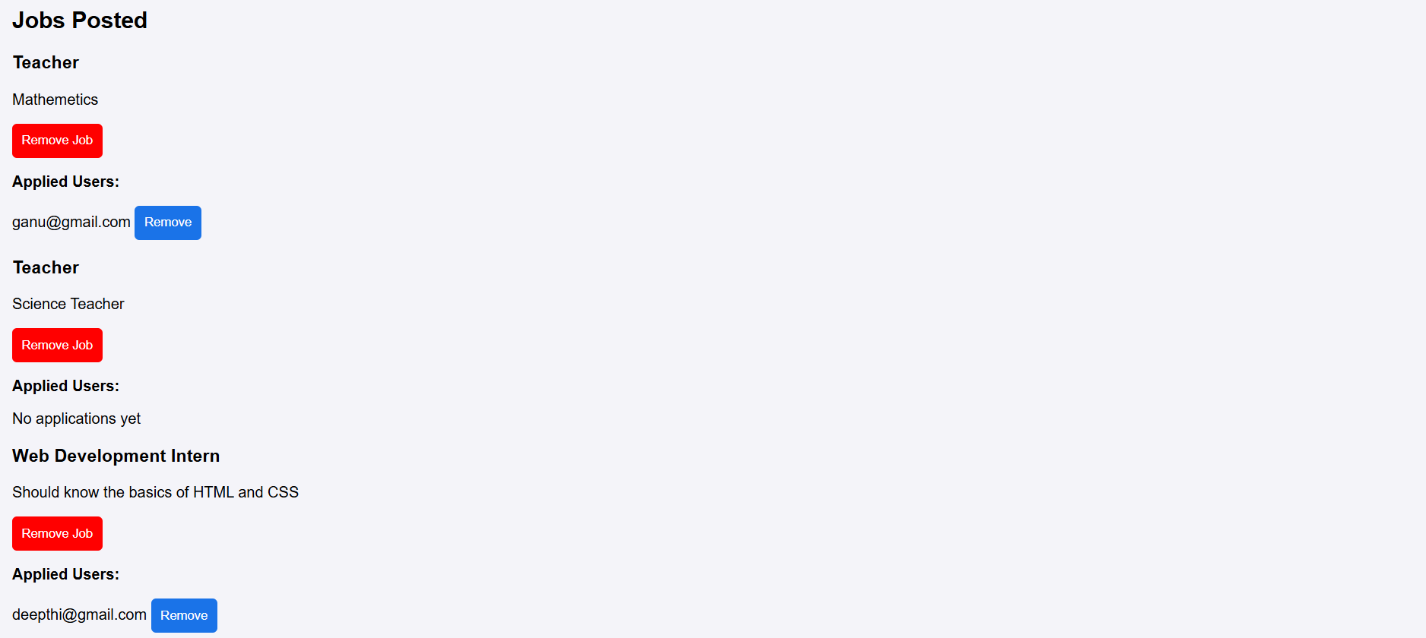
Output Screenshots:
Admin Page:

Slide 11
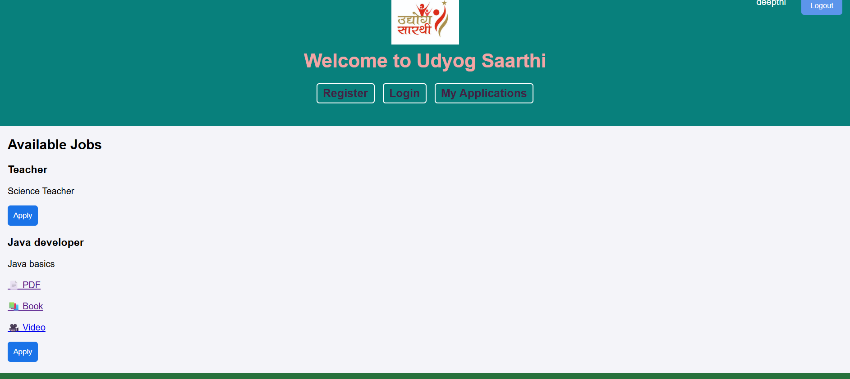
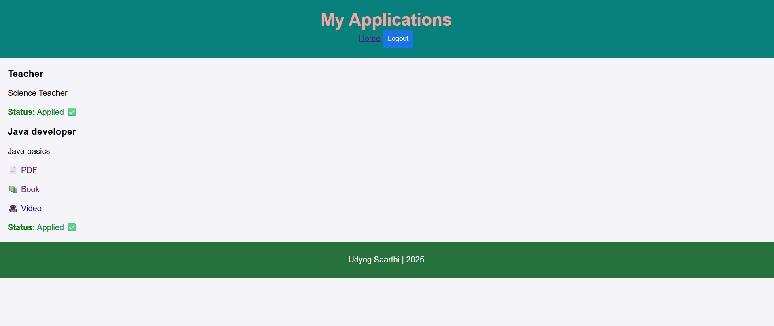
Output Screenshots:
User Home Page:
My Applications Page:

Slide 12
Results and Testing:
All modules successfully integrated.
Functional testing completed on browser and mobile.
App supports offline use (PWA).
User experience improved through simple UI.
Conclusion:
Provides an inclusive job platform for PwDs.
Ensures transparency and usability for all stakeholders.
Promotes employment and empowerment for persons with disabilities.
Prototype can be extended with backend integration for real-world use.

Slide 13
References:
PMC Study on PwD Employment in India
IJRSR Journal on Opportunities and Challenges for PwDs
CSR Journal Report on Job Portals for PwDs
ETHRWorld Article – India’s First AI-based PwD Job Platform
Ministry of Statistics, “Persons with Disabilities Report,” Govt. of India, 2021.
Ministry of Social Justice and Empowerment, “Rights of Persons with Disabilities Act (RPwD),” 2016.

Slide 14


